Slide 1
Lesson 29 Web Content
Computer Literacy BASICS: A Comprehensive Guide to IC³, 4th Edition
Morrison / Wells

Slide 2
Objectives
Understand Internet content.
Search for information on the Web.
Use a search engine.
Evaluate the quality of Internet information.
Identify how to evaluate the quality of information.
Observe intellectual property laws.
2
2

Slide 3
Vocabulary
blog
Boolean logic
copyright
directory
feed
index
keyword
libel
link list
math symbol
news feed
phrase searching
plagiarism
podcatcher
3
3

Slide 4
Vocabulary (continued)
public domain
related search
search engine
shared bookmark
trademark
wiki
wildcard character
4
4

Slide 5
Understanding Internet Content
You can create online content on the following types of sites:
Web pages and Web sites are created by schools, governments, institutions, companies, nonprofit agencies, individuals, and others.
A blog generally is managed by one person or a small group.
A wiki is a collaborative Web site that can be edited by anyone with access.
5
5

Slide 6
Understanding Internet Content (continued)
Social networking sites, such as Facebook, MySpace, Bebo, Twitter, LinkedIn, hi5, Orkut, and others attract millions of users.
A podcast is a collection of multimedia files that can be downloaded from the Internet to a mobile device or personal computer.
File-sharing sites, including those for sharing photos, music, and video use a peer-to-peer (P2P) network, which connects computers directly instead of through a central server.
6
6

Slide 7
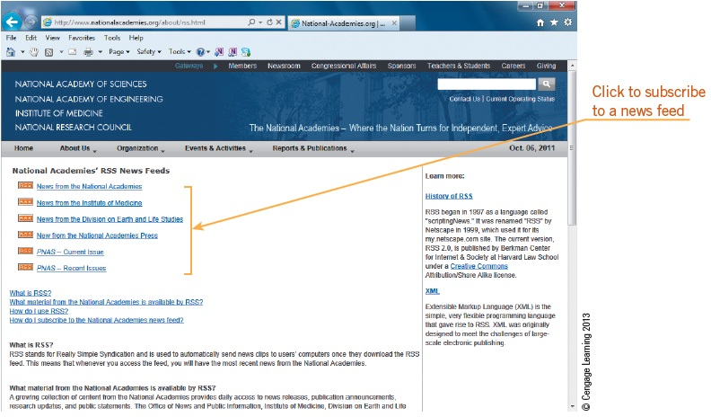
Understanding Internet Content (continued)
A news feed is a data format for providing users with frequently updated content.
7
7

Slide 8
Searching for Information on the Web
When searching online, one of the primary tools you can use to find information is a search engine.
You use a search engine to search for keywords.
You can use general search engines and special-purpose search engines.
8
8

Slide 9
Searching for Information on the Web (continued)
You can find online information using other tools:
Indexes, also called directories, are Web sites that are organized by categories.
Link lists are collections of links on a particular topic.
A shared bookmark is a form of collaborative information sharing that lets users organize and share favorites, or bookmarks.
9
9

Slide 10
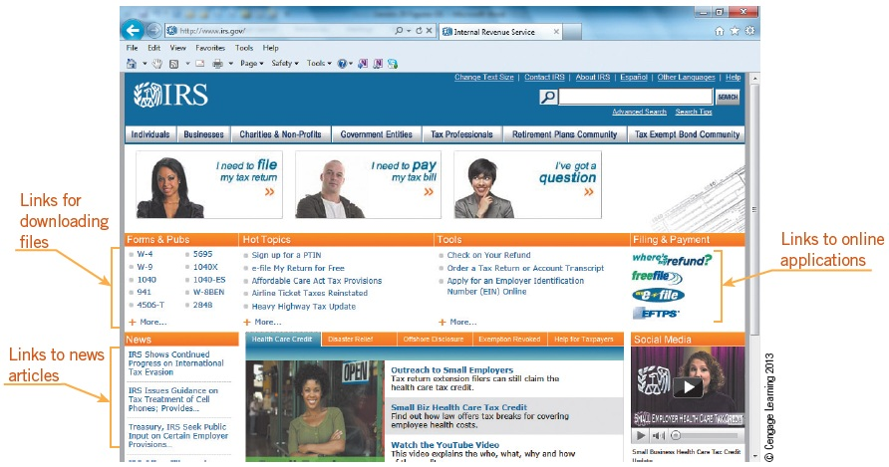
Searching for Information on the Web (continued)
A traditional Web site, an informational site, or government sites, generally contains links within the content.
10
10

Slide 11
Using a Search Engine
Phrase Searching:
To search for words that appear next to each other, phrase searching is your best choice.
Search Engine Math:
Math symbols make keywords more specific and narrow your search results.
Boolean Searching:
Boolean logic uses AND, NOT, and OR.
11
11

Slide 12
Using a Search Engine (continued)
Wildcard Searching:
The * symbol, or asterisk, is considered a wildcard character.
Title Searching:
You can search within the HTML document for the title of a Web page.
Other Search Features:
A related search is preprogrammed queries or questions suggested by the search engine.
12
12

Slide 13
Evaluating the Quality of Internet Information
Criteria for determining information quality:
Relevance and reliability
Page layout
Validity and bias
Writing style
Coverage
13
13

Slide 14
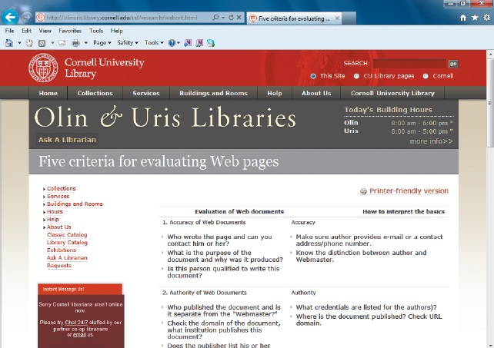
Evaluating the Quality of Internet Information (continued)
Evaluating Web Sites:
The Cornell University Library provides five criteria for evaluating Web pages.
14
14

Slide 15
Observing Intellectual Property Laws
Copyright is the exclusive right, granted by law for a certain number of years, to make and use literary, musical, or artistic work, which is considered intellectual property.
Material in the public domain is available for anyone to copy or use.
15
15

Slide 16
Observing Intellectual Property Laws (continued)
Citing Internet Resources:
You must cite Internet resources used in reports and other documents.
Claiming someone else’s words as your own is plagiarism.
Respecting Others:
Libel is a statement that makes a claim, expressly stated or implied to be factual, that may give an individual, business, product, group, government or nation a negative image.
16
16

Slide 17
Observing Intellectual Property Laws (continued)
Online Responsibilities:
Use common sense; the content and tone should be appropriate for the intended audience.
Behave online the way you would behave in your daily life.
Indicate if a statement is fact or your opinion.
Include contact information.
Update your information on a regular basis.
Do not berate or harass others.
17
17

Slide 18
Summary
In this lesson, you learned:
You typically create content for the Internet by publishing it on a Web page and providing links for navigation. Viewers visit your site and interact with the information you provide. Web 2.0 technology lets you invite Web page viewers to contribute information to a site or exchange information, messages, and files with other viewers.
18
18

Slide 19
Summary (continued)
When searching online, one of the primary tools you can use to find information is a search engine. You use a search engine to search for keywords
Keywords describe the information you are trying to locate. Most search engines support keyword searches. Use double quotation marks around a set of words for phrase searching.
19
19

Slide 20
Summary (continued)
Use the plus and minus signs for including or excluding words within a search. Boolean searches use the three logical operators OR, AND, and NOT.
Many search engines offer advanced search options that let you filter search results with specific criteria. Use the * symbol for wildcard searching.
To evaluate Web sites, consider relevance and reliability, page layout, validity and bias, writing style, and coverage.
20
20

Slide 21
Summary (continued)
Cite any information that you use from the Internet. The MLA style is widely used for citing electronic resources.
21
21

